Slide 1
Explore Zomato restaurants dataset in the city of New Delhi

Slide 2
INTRODUCTION
India is one of the most tourist visited countries in the world for its monuments, culture, traditions and the list could go on and on. There is lot of tourist market in india and New delhi is one of the most visited places for lot of tourists to catch the glimpse of Taj mahal, Red fort etc.,
New Delhi is the capital city of India. It is a part of the city of Delhi’s 11 districts. The city itself has a population of 257,803. However, the much larger metro area has a population that exceeds 26 million. New Delhi are used interchangeably to refer to the National Capital Territory of Delhi (NCT), these are two distinct entities, with New Delhi forming a small part of Delhi. The National Capital Region is a much larger entity comprising the entire NCT along with adjoining districts in neighbouring states.
The official language of New Delhi and the one that is most widely spoken is Hindi. However, English is also spoken as a formal language within businesses and government agencies. Over last decades it is continuously grow because of the city’s important role in government and commercial business.
With it’s diverse culture , comes diverse food items. There are many restaurants in New Delhi City, each belonging to different categories like Chinese , Italian , French etc.

Slide 3
OBJECTIVES
The idea of my project is to present the client and stake holders with answers to the following questions:
Which areas have the best restaurants in New Delhi?
What is best location in New Delhi City for the famous Biryani?
What is best location in New Delhi City for Chinese Cuisine?
Which areas of all areas have large number of Chinese Restaurant Market?
Which area of all areas have less number of restaurants?
Which area of all areas have most number of restaurants?
Which is the best place to stay if I prefer Chinese Cuisine?

Slide 4
DATA
For this project we need the following data :
New Delhi Restaurants data that contains list Locality, Restaurant name,Rating along with their latitude and longitude.
Data source : Zomato kaggel dataset
Description : This data set contains the required information. And we will use this data set to explore various locality of new delhi city.
Nearby places in each locality of new delhi city.
Data source : Fousquare API
Description : By using this api we will get all the venues in each neighborhood.

Slide 5
Approach
Collect the new delhi city data from Zomato kaggel dataset
Using FourSquare API we will find all venues for each neighborhood.
Filter out all venues that are nearby by locality.
Using aggregative rating for each resturant to find the best places.
Visualize the Ranking of neighborhoods using folium library(python)

Slide 6
Results

Slide 7
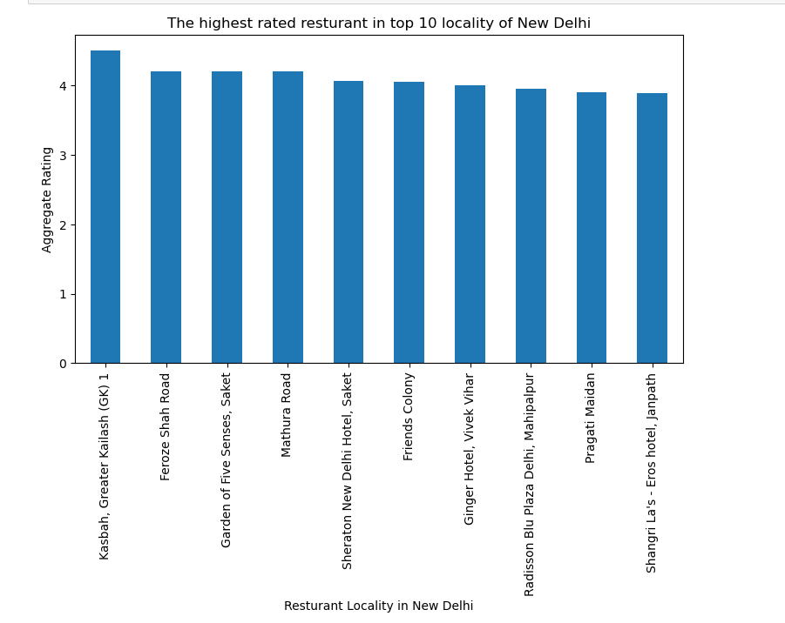

Slide 8
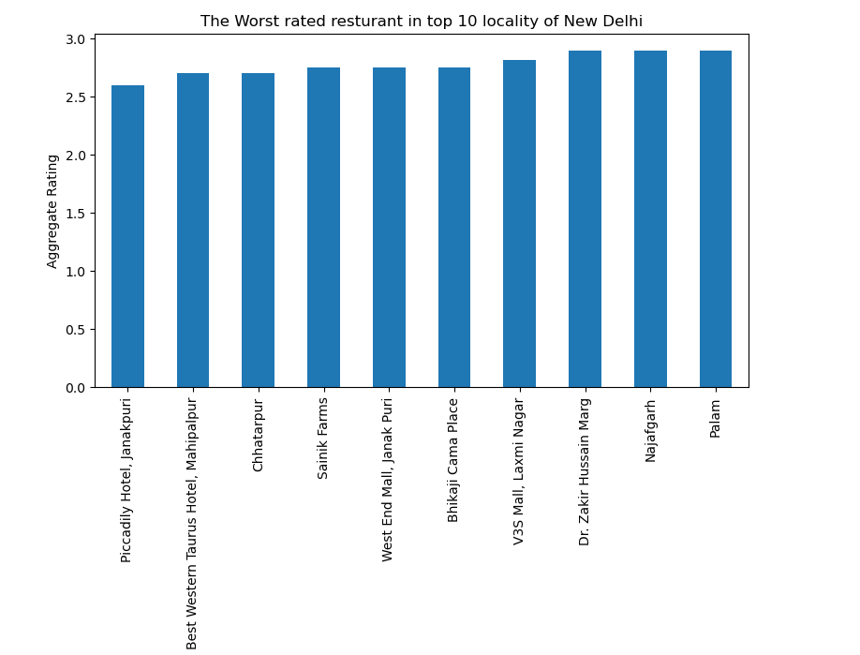

Slide 9
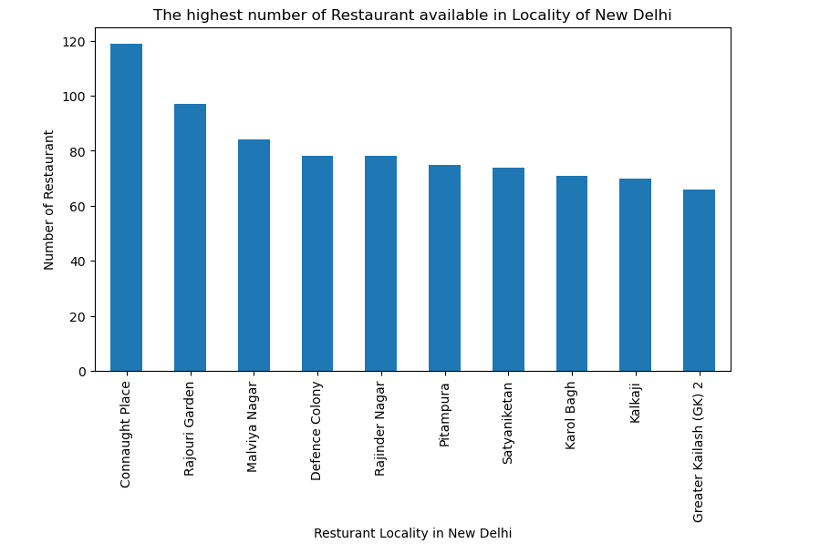

Slide 10
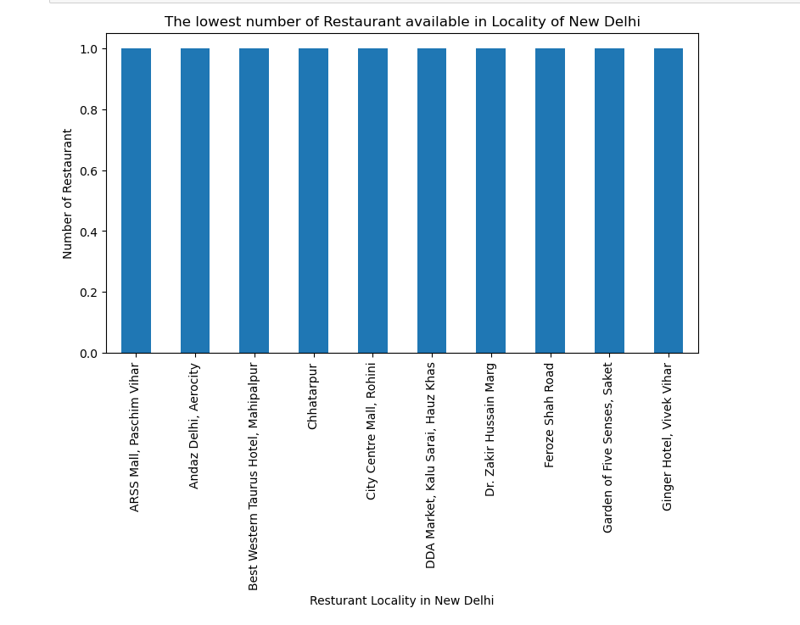

Slide 11
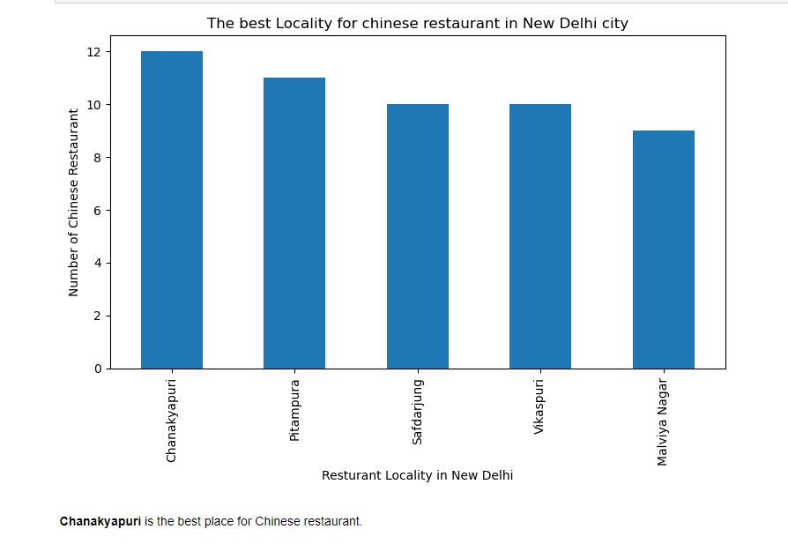

Slide 12
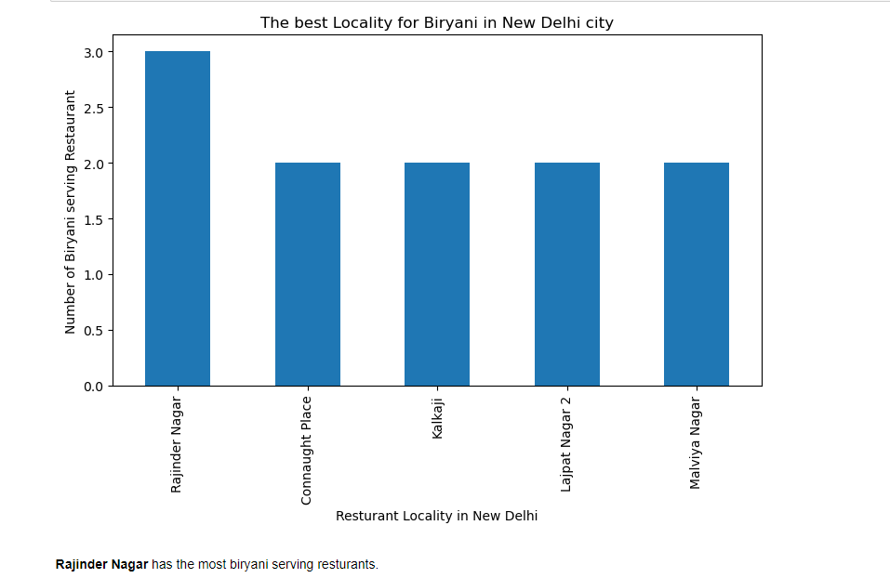

Slide 13
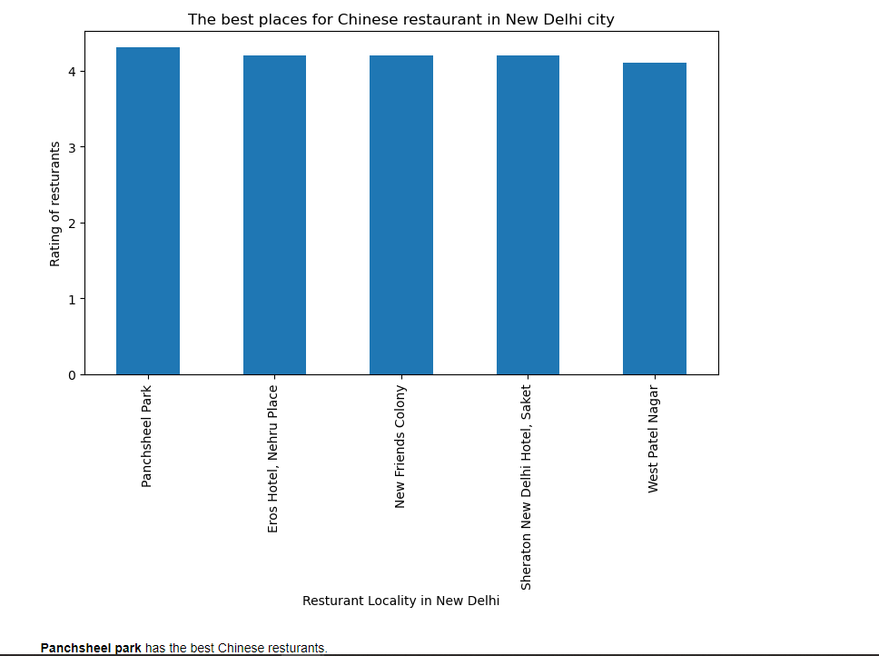

Slide 14
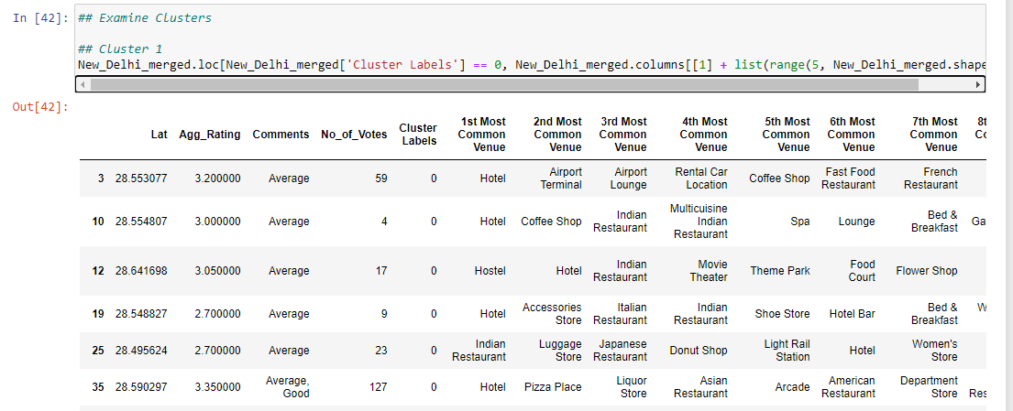
Cluster 1:
The Hotels are most recommended venues nearby the locations.

Slide 15
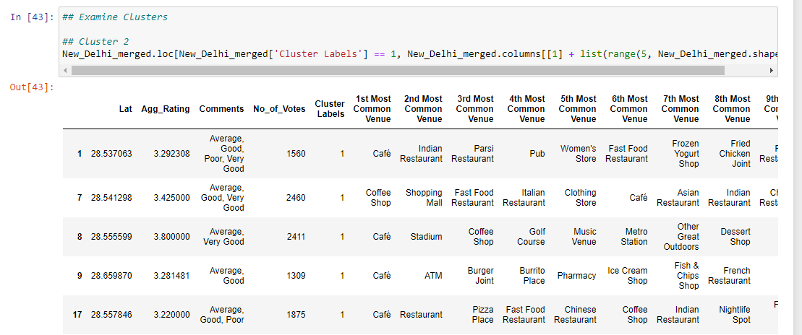
Cluster 2:
It is recommended for the cafes, Coffee shops

Slide 16
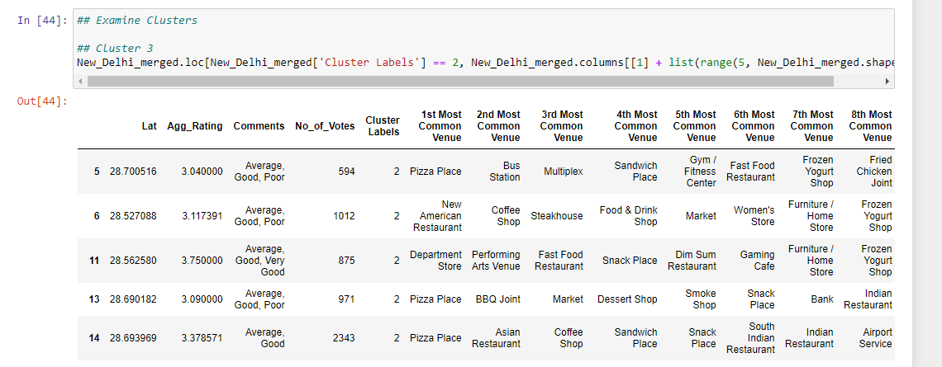
Cluster 3:
It seems like fast food

Slide 17
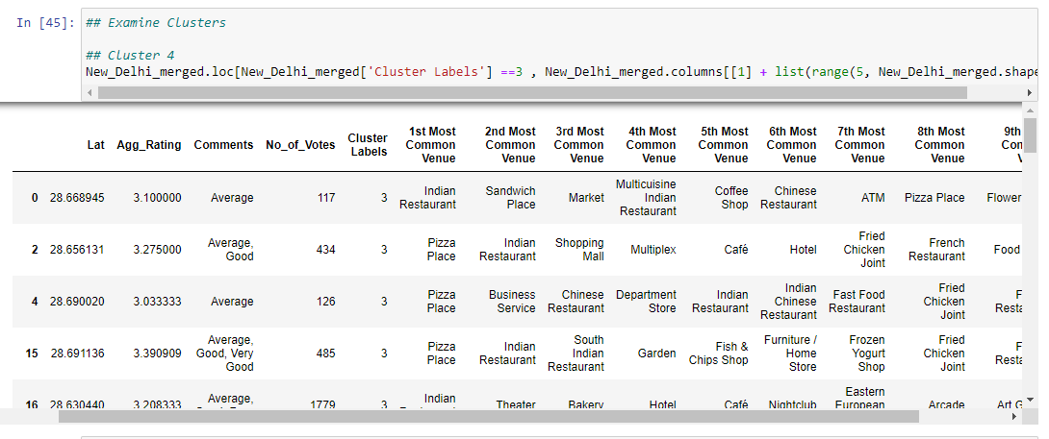
Cluster 4:
It’s most recommended for Indian Restaurants and Pizza places

Slide 18
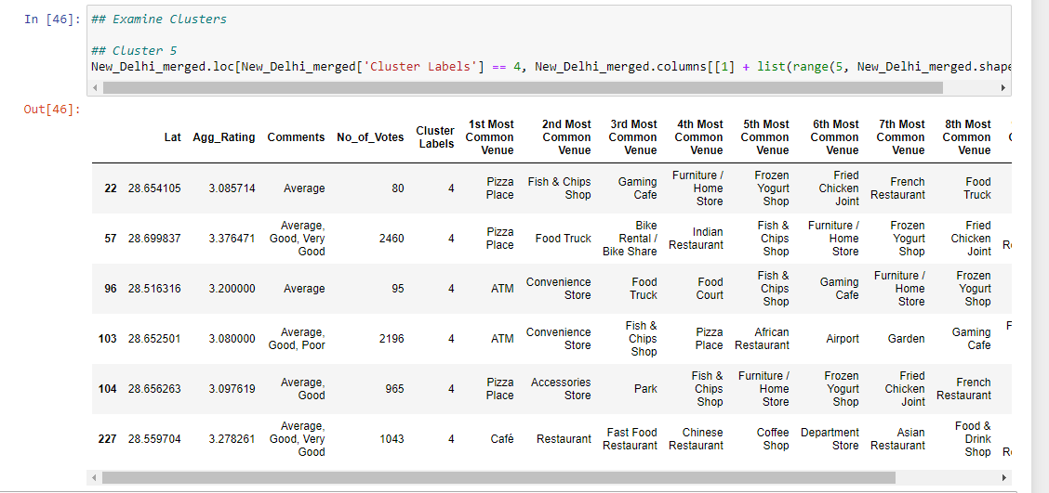
Cluster 5:
ATMS and Pizza places are the most recommended venues

Slide 19
Conclusion
Chanakyapuri, Pitampura, Safdarjung are some of the best neighborhoods for Chinese cuisine.
Pancsheel park, Nehru place have the best Chinese Resturant.
Cannaught place, Rajouri garden, Malviya nagar has most restaurents .
Rajinder Nagar has the most biryani serving resturants.
Greater kailash, Feroze shah road, Saket have best resturants in New Delhi.

